Slide 1
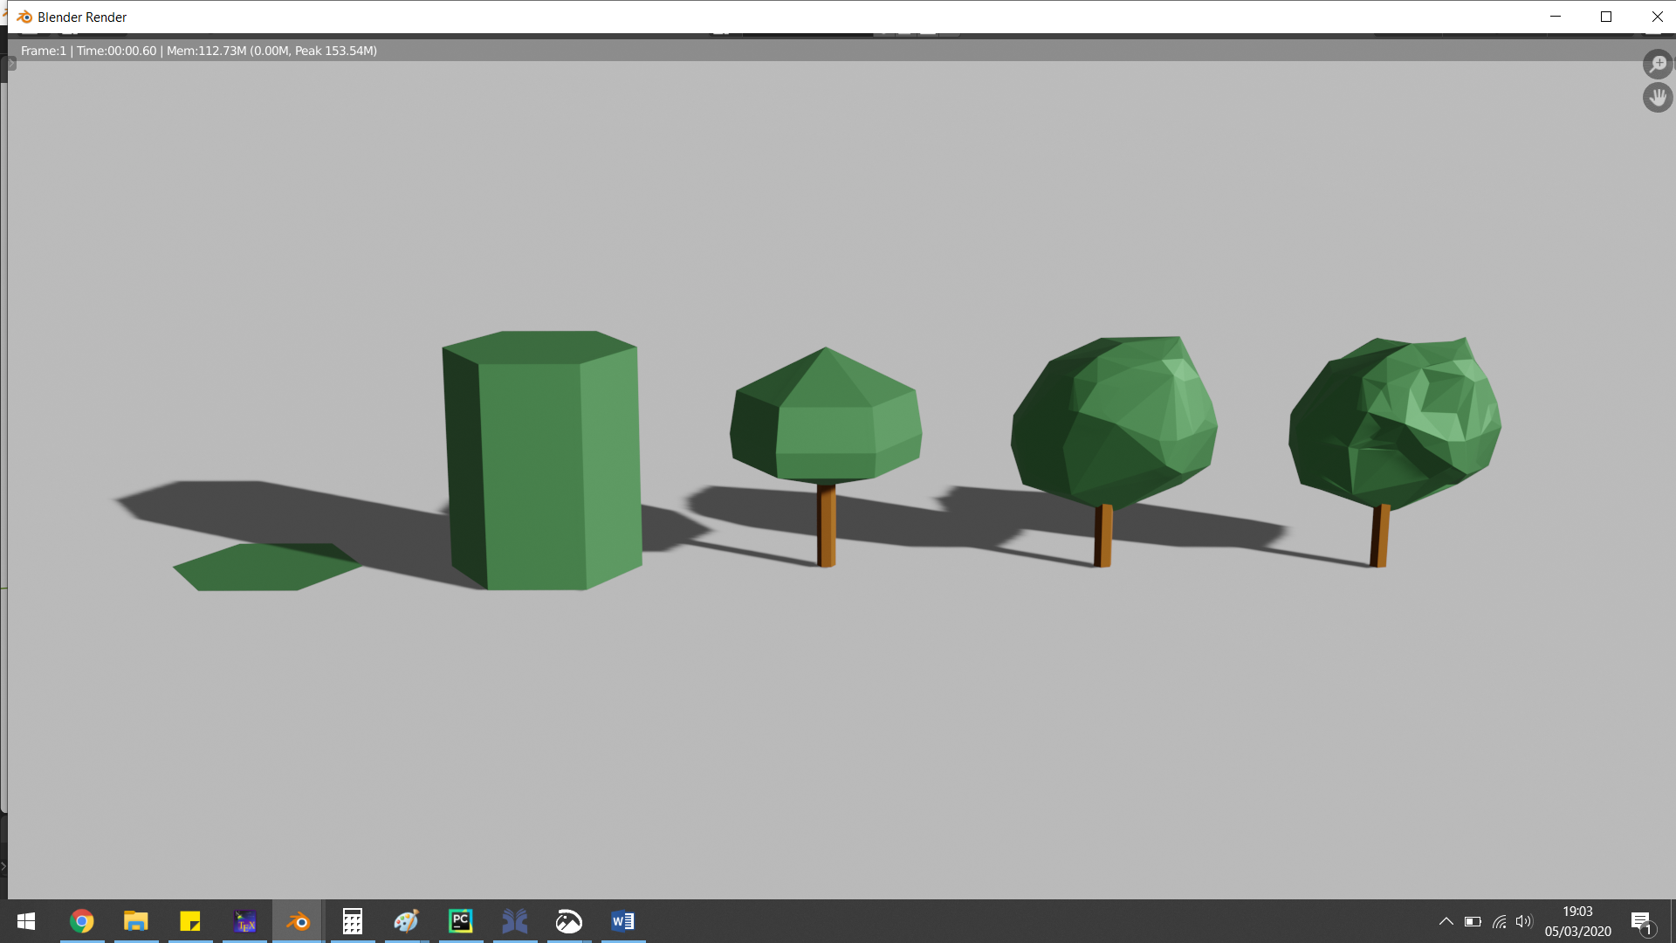


Automatic construction of 3D tree models from airborne LiDAR data in multiple levels of detail
Geert Jan (Rob) de Groot
g.j.robdegroot@gmail.com
Supervisors:
Prof. dr. Jantien Stoter
Dr. Hugo Ledoux

Slide 2
Contents
Introduction
Methodology
Results
Conclusions
Introduction
Methodology
Results
Conclusions

Slide 3
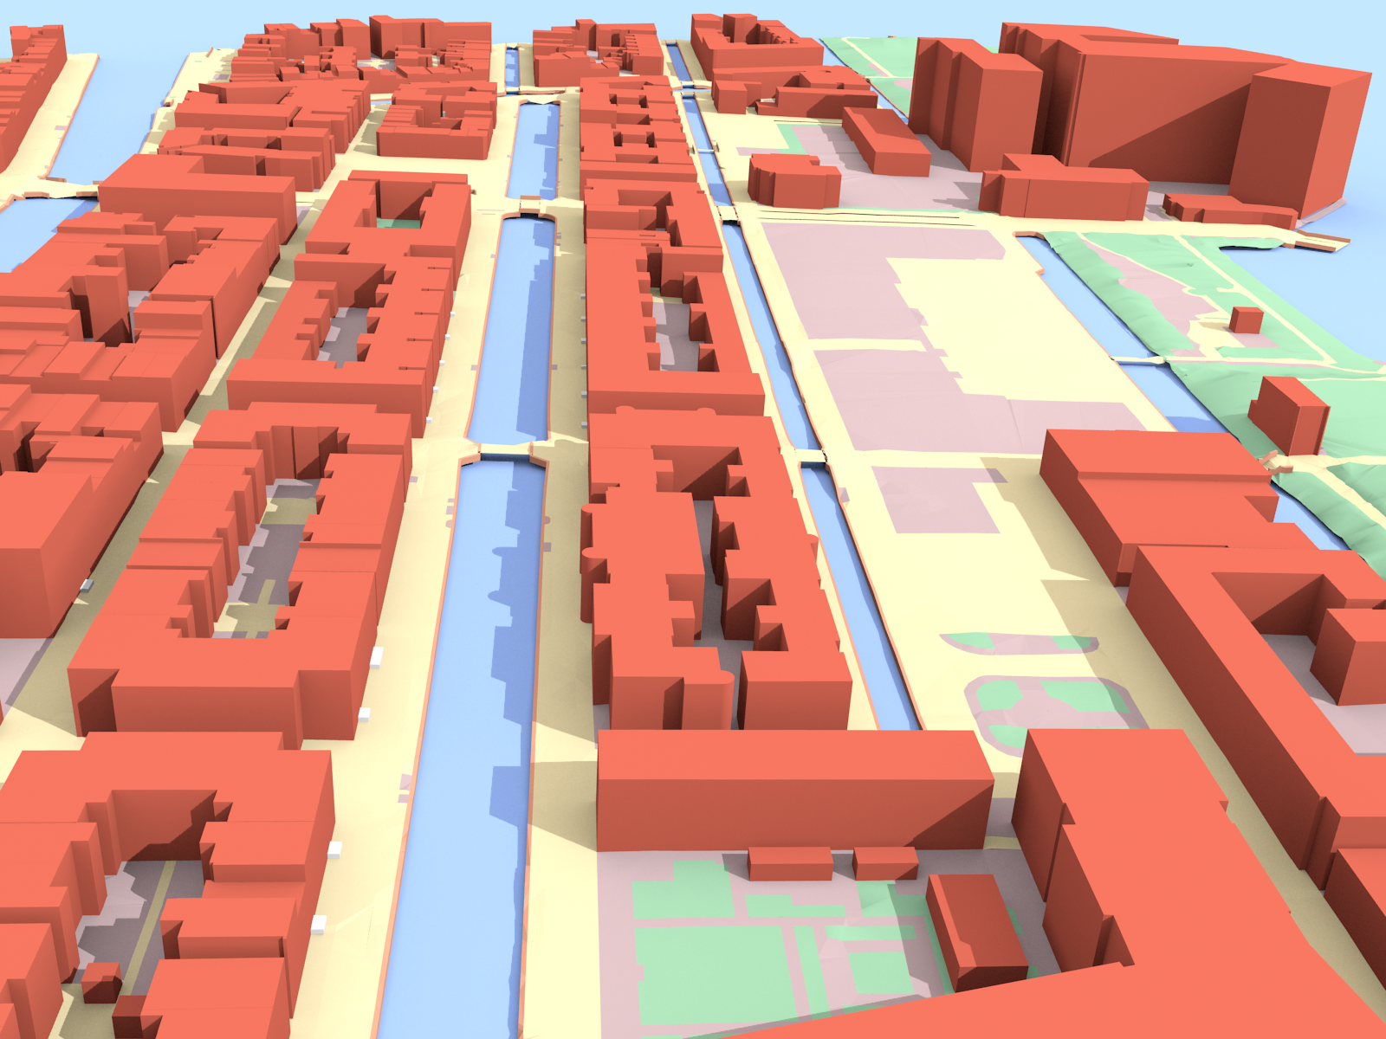
Goal
Introduction
Methodology
Results
Conclusions
3dfier output (3D Geoinformation Group, 2019)

Slide 4
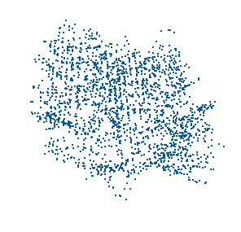
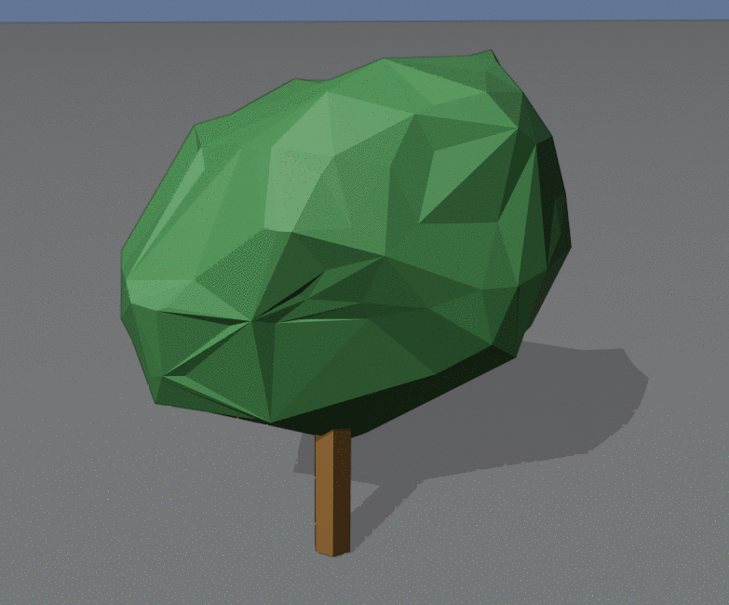
Goal
Introduction
Methodology
Results
Conclusions

Slide 5
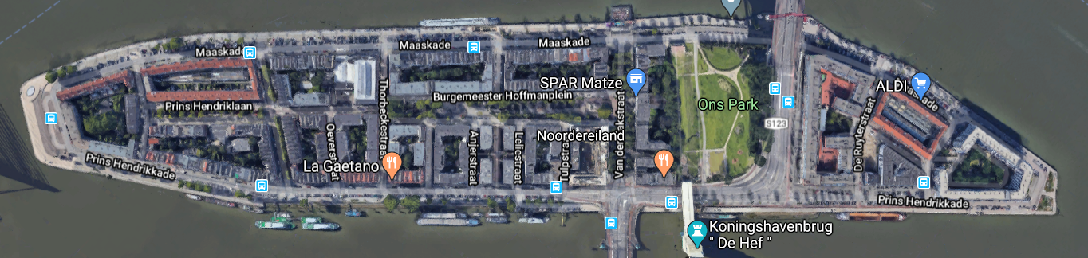
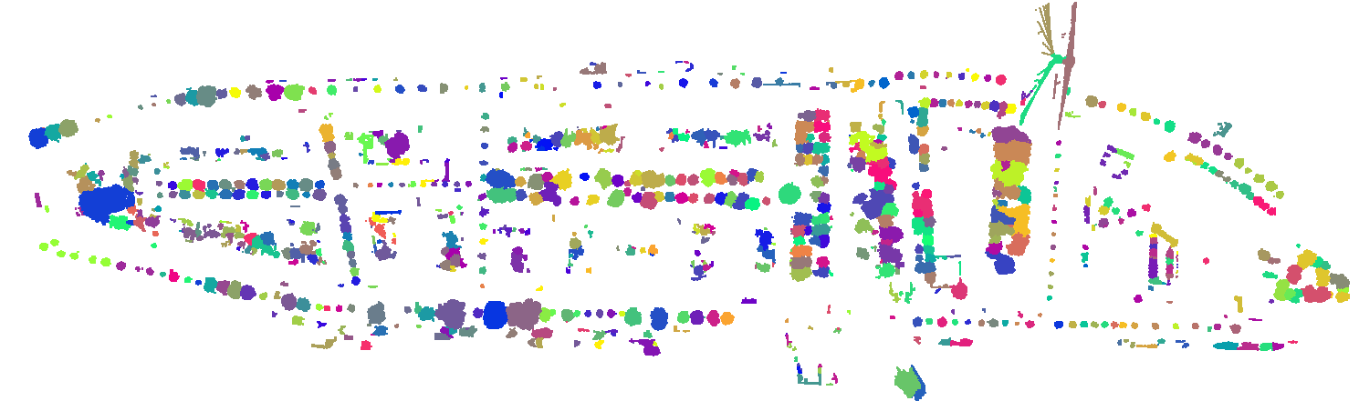
Goal
Introduction
Methodology
Results
Conclusions

Slide 6
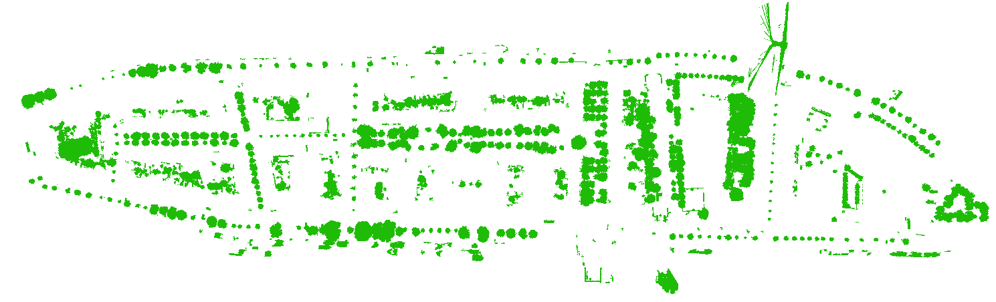
Goal
Introduction
Methodology
Results
Conclusions

Slide 7
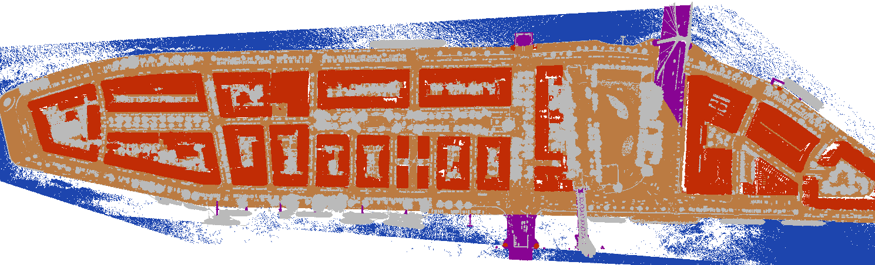
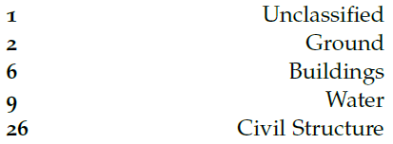
Goal
Introduction
Methodology
Results
Conclusions

Slide 8
Research Questions
Introduction
Methodology
Results
Conclusions
How can 3D tree models at varying Levels of Detail be automatically constructed from airborne LiDAR point cloud data?

Slide 9
Research Questions
How can 3D tree models at varying Levels of Detail be automatically constructed from airborne LiDAR point cloud data?
What applications require what type or Level of Detail (LOD) of 3D tree models?
What LODs are most fitting for which type of tree models (single vegetation object or vegetation group)?
How can a final implementation be made to fit into the 3dfier pipeline?
Is it possible to determine which tree type a tree belongs to, based on features that can be extracted from trees in airborne LiDAR point cloud data?
Introduction
Methodology
Results
Conclusions

Slide 10
Approach
Classification
Introduction
Methodology
Results
Conclusions
Segmentation
Data-cleaning
Modelling
Tree-type Classification

Slide 11
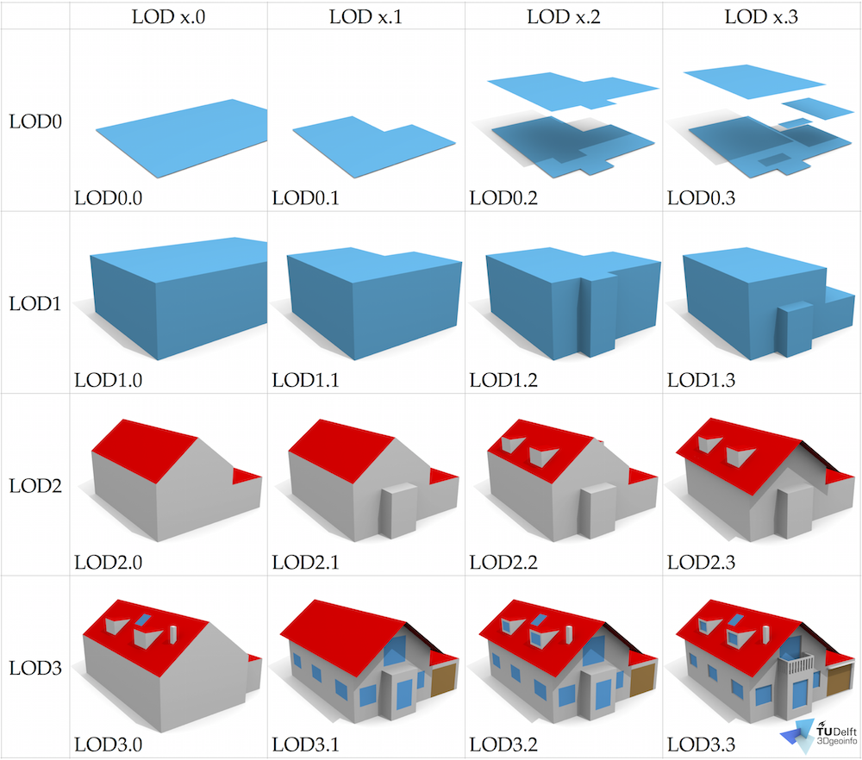
Proposal
Introduction
Methodology
Results
Conclusions
LOD Specifications (Biljecki et al., 2016)

Slide 12
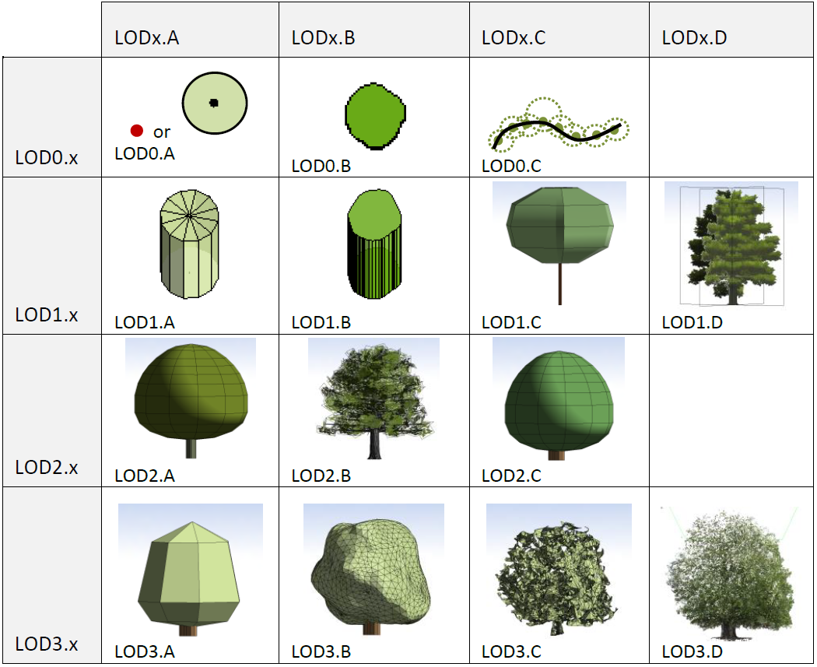
Proposal
Introduction
Methodology
Results
Conclusions
LOD Proposal (Ortega-C’ordova, 2018)

Slide 13

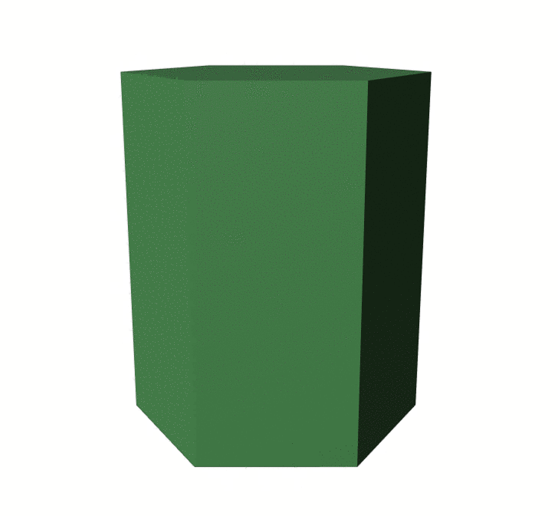
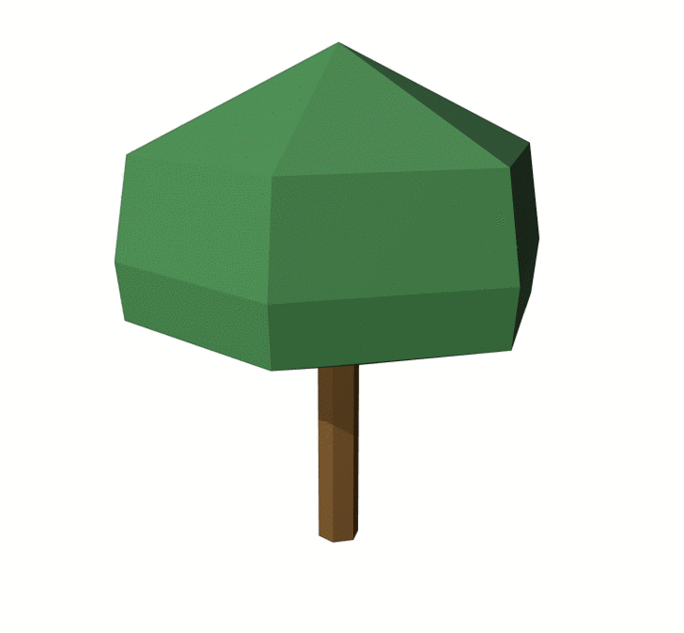
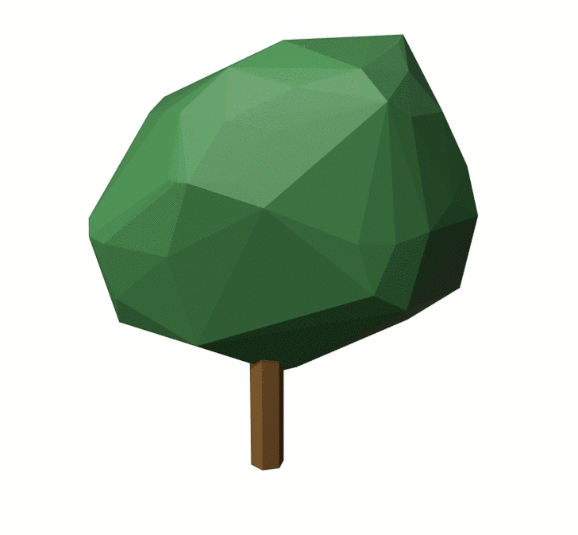
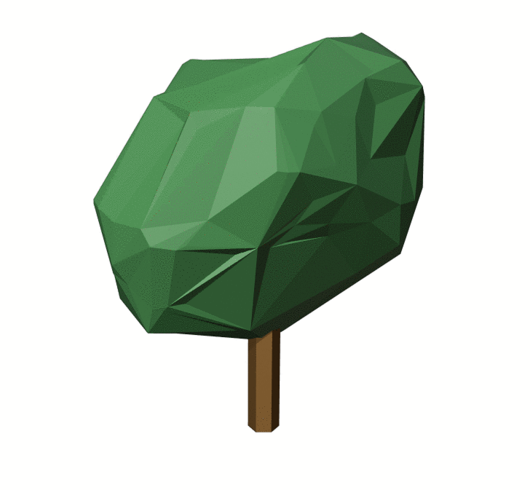
Proposal
Introduction
Methodology
Results
Conclusions
LOD0 LOD1 LOD2 LOD3.0 LOD3.1

Slide 14



Classification
Introduction
Methodology
Results
Conclusions
Height from ground
Planarity
Ruggedness

Slide 15
Classification
Introduction
Methodology
Results
Conclusions

Slide 16
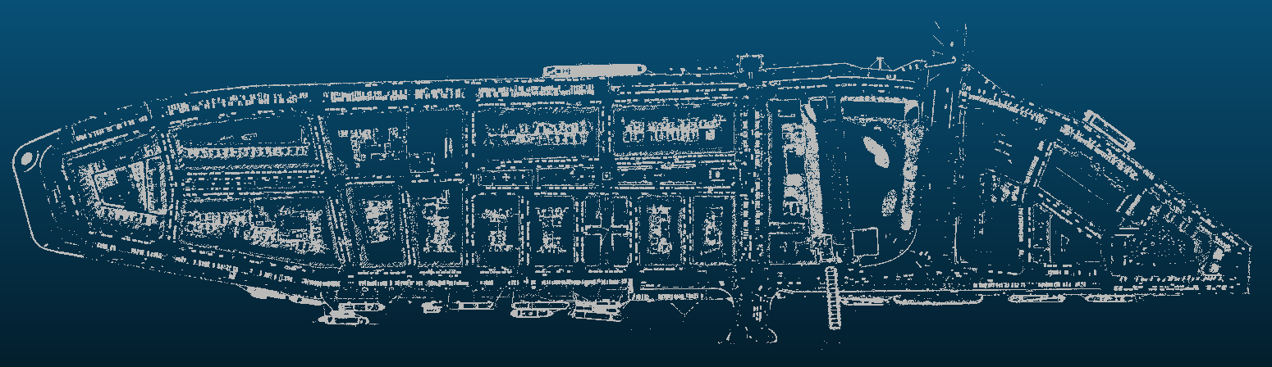


Classification
Introduction
Methodology
Results
Conclusions

Slide 17
Classification
Introduction
Methodology
Results
Conclusions

Slide 18
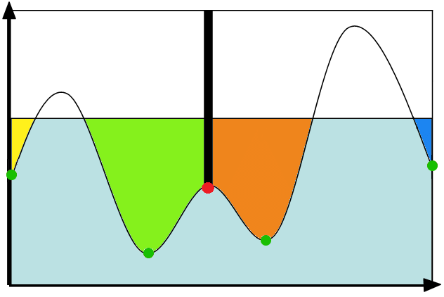
Segmentation
Seeds
Saddle
Introduction
Methodology
Results
Conclusions
Watershed segmentation (Roudier et Al., 2008)

Slide 19
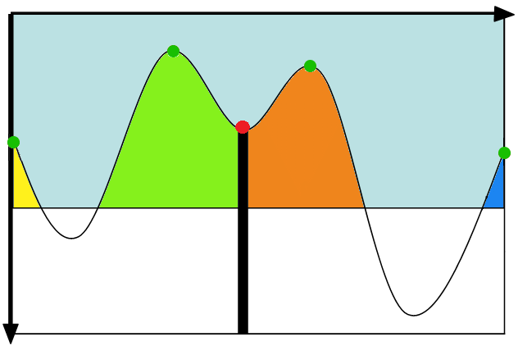
Segmentation
Seeds
Saddle
Introduction
Methodology
Results
Conclusions
Watershed segmentation (Roudier et Al., 2008)

Slide 20
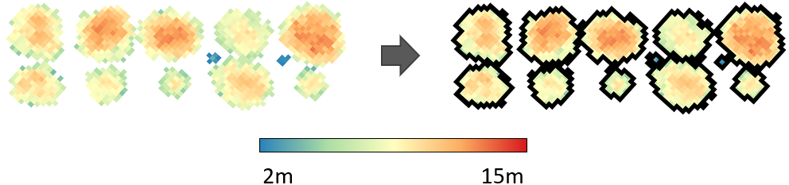
Segmentation
Introduction
Methodology
Results
Conclusions
DEM
Segmented DEM

Slide 21
Segmentation
Introduction
Methodology
Results
Conclusions

Slide 22
Segmentation
Introduction
Methodology
Results
Conclusions

Slide 23
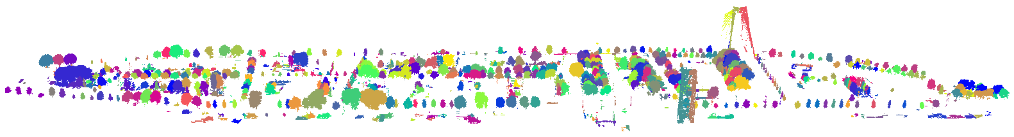
Segmentation
Introduction
Methodology
Results
Conclusions

Slide 24
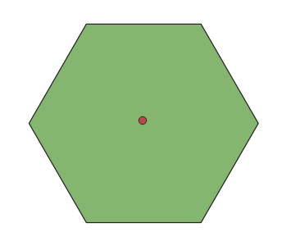
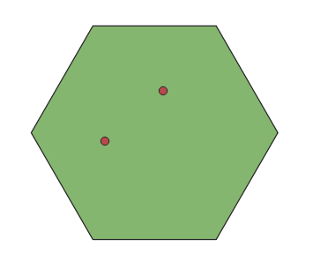
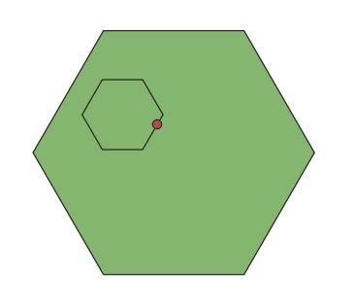
Segmentation
Introduction
Methodology
Results
Conclusions
Good Under Over

Slide 25
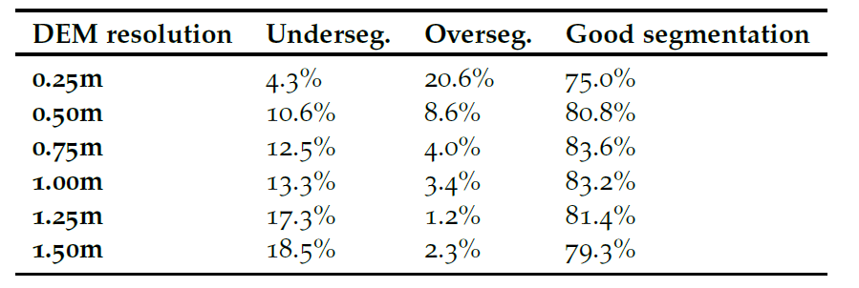
Segmentation
Introduction
Methodology
Results
Conclusions

Slide 26
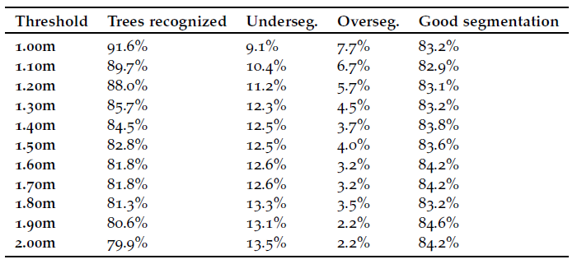
Segmentation
Introduction
Methodology
Results
Conclusions

Slide 27
Segmentation
Introduction
Methodology
Results
Conclusions
84.5% * 83.8% ≈ 70%

Slide 28
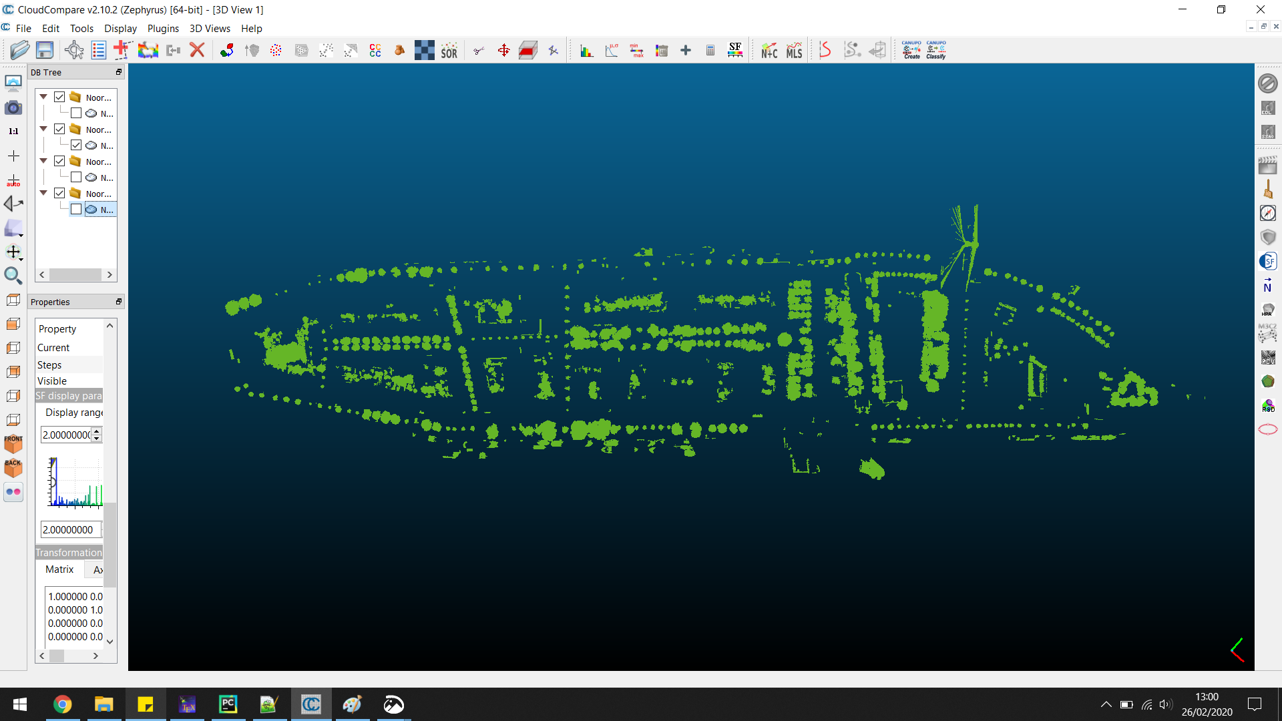
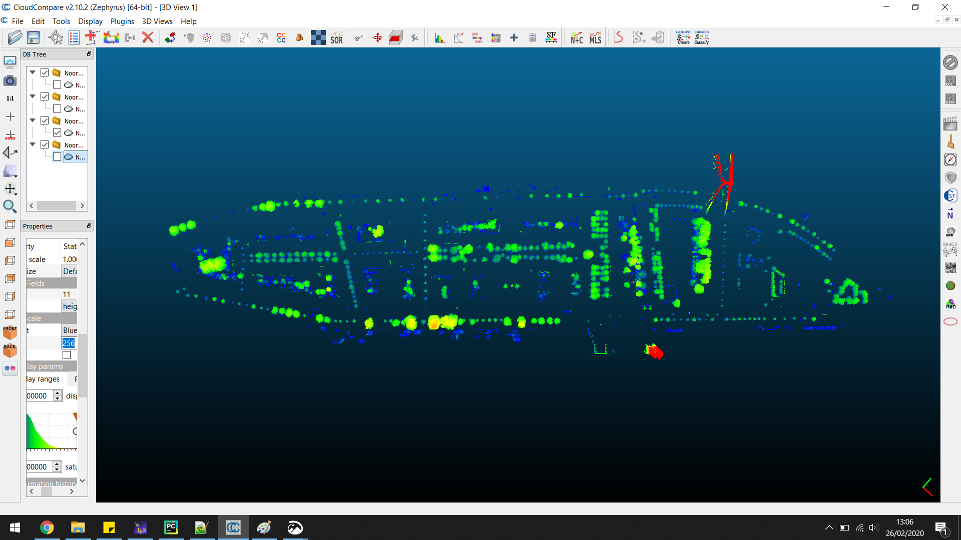
Data Cleaning
Introduction
Methodology
Results
Conclusions

Slide 29
Data Cleaning
Filter
Introduction
Methodology
Results
Conclusions
Planarity Check
Sub-Planarity Check
Outlier Removal

Slide 30
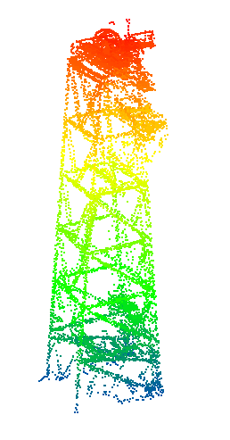
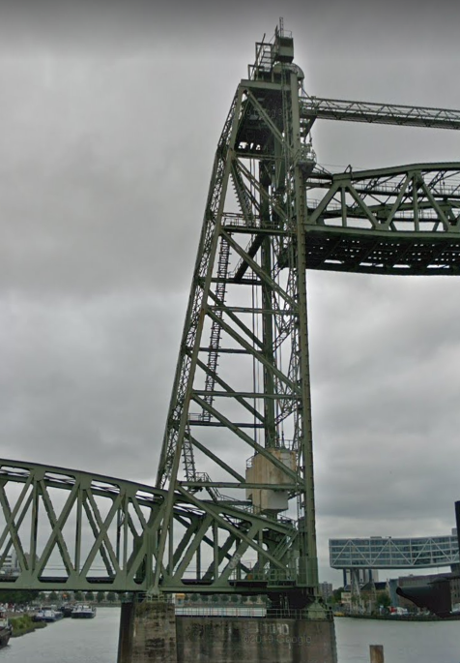
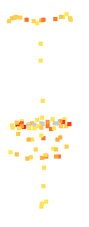
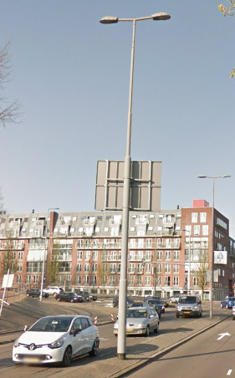
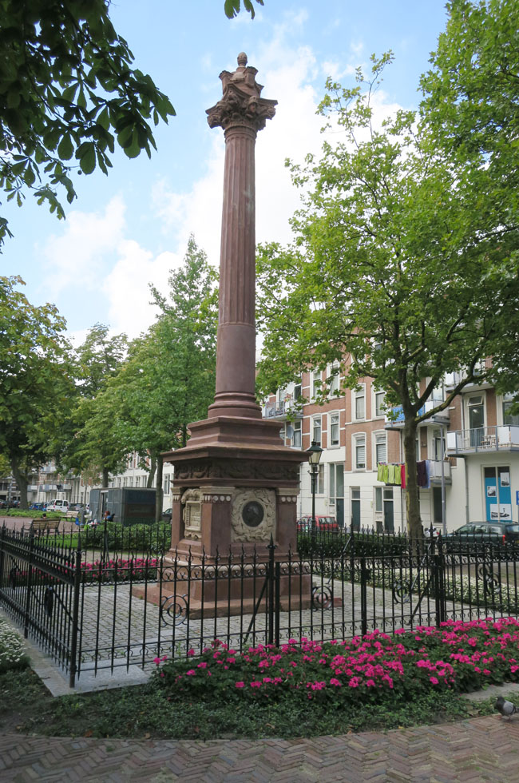
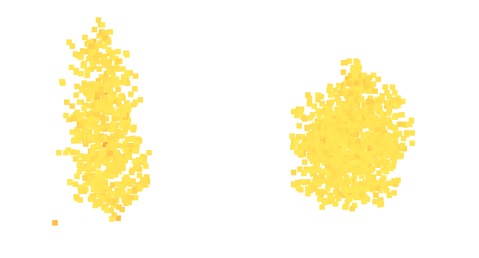
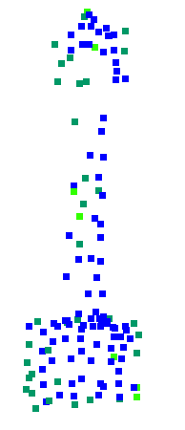
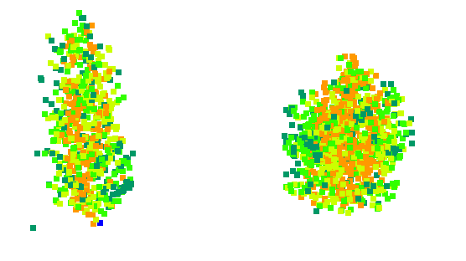
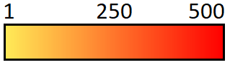

Filter
Rules:
A segment needs to consist of at least 50 points
A segment’s average intensity value needs to be below 100
A segment’s average number of returns should be above 1.5
A segment’s maximum height is 50m
Introduction
Methodology
Results
Conclusions
Max height: 70m
Avg. Intensity: 1460
Avg. nr of returns: 1.3

Slide 31
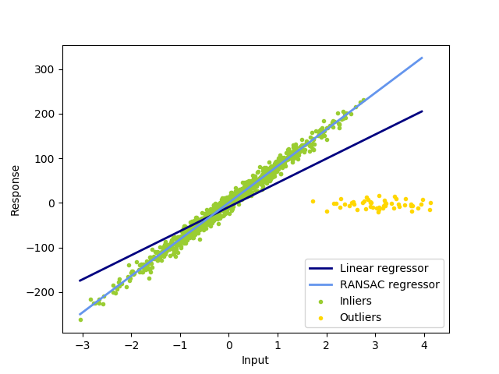
Planarity Check
Random Sample Consensus (RANSAC)
Introduction
Methodology
Results
Conclusions
2D RANSAC (Pedregosa et Al., 2008)

Slide 32
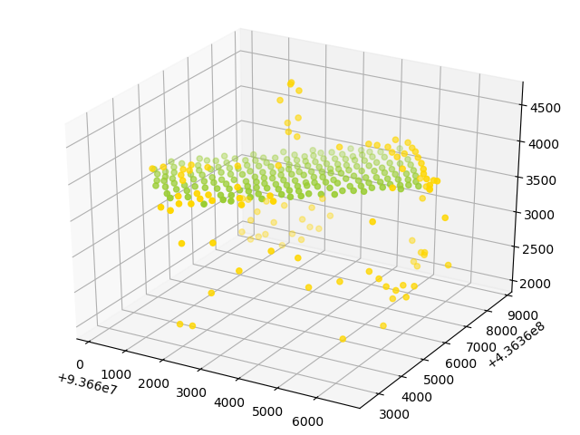
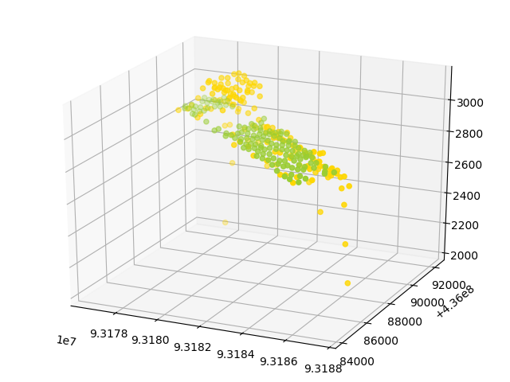
Planarity Check
Remove:
Introduction
Methodology
Results
Conclusions
Distance < 100mm

Slide 33
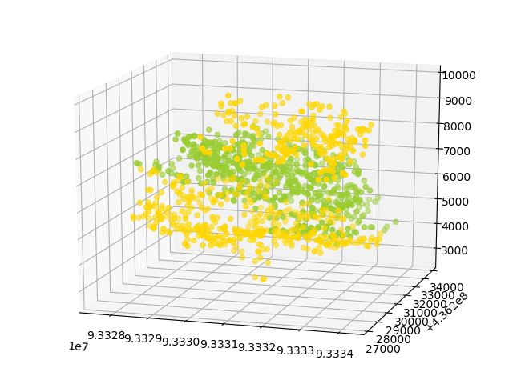
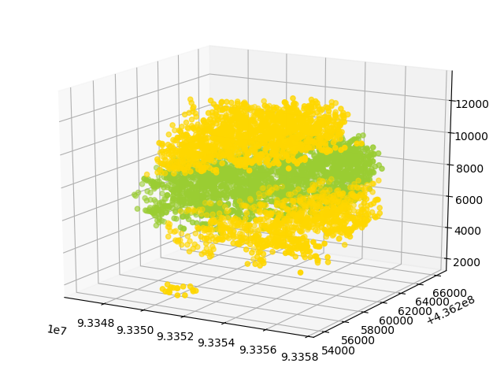
Planarity Check
Do not remove
Introduction
Methodology
Results
Conclusions
Distance > 100mm

Slide 34
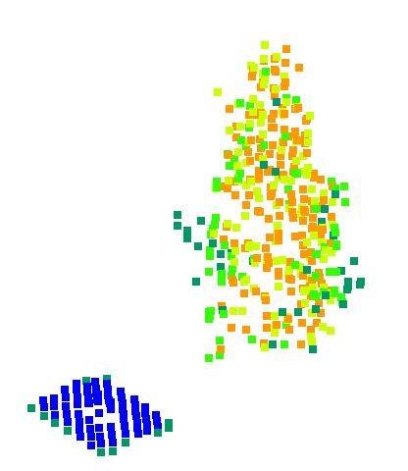
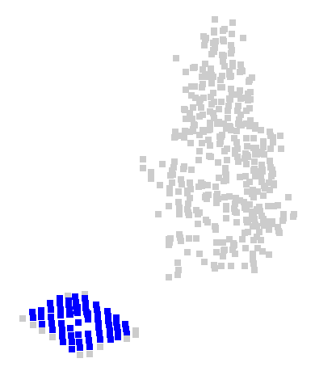
Sub-Planarity Check
Introduction
Methodology
Results
Conclusions
Low number of returns to identify planes within segments

Slide 35
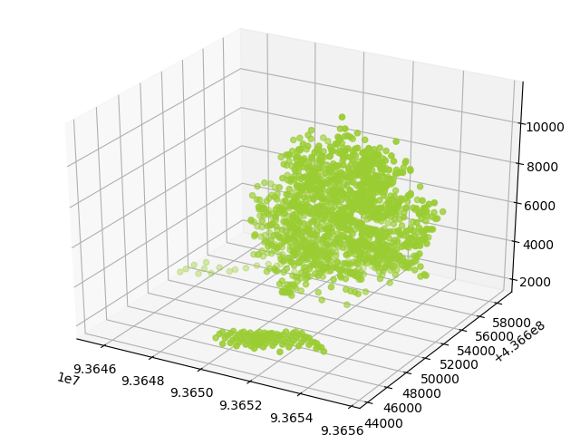
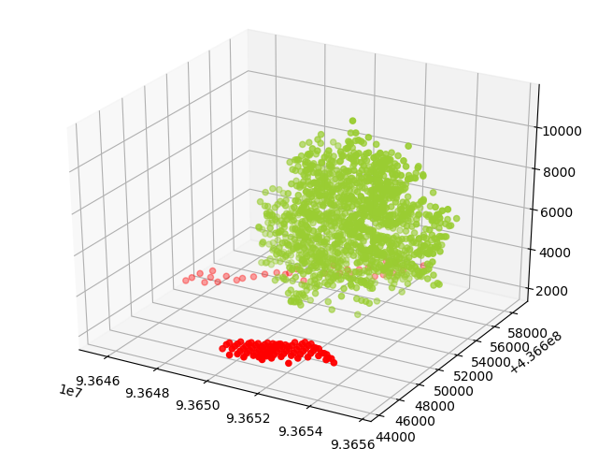
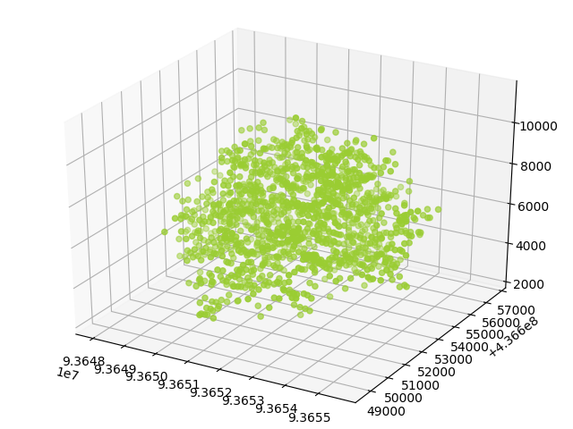
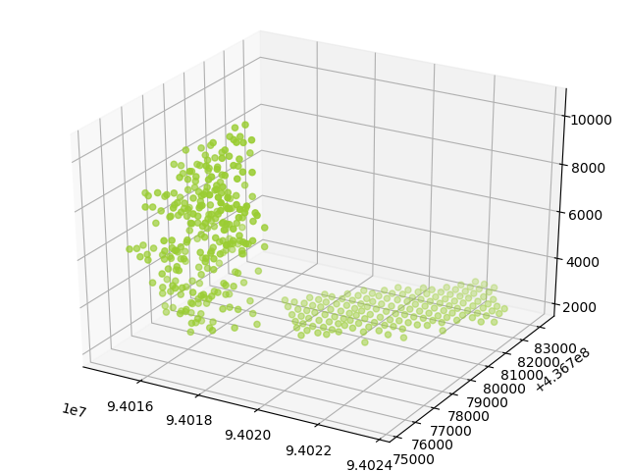
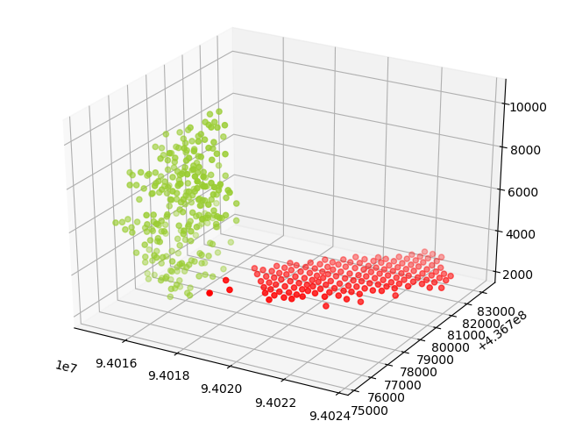
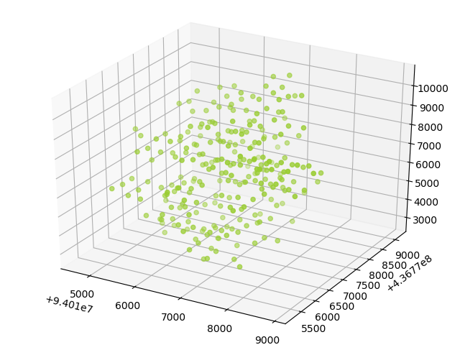
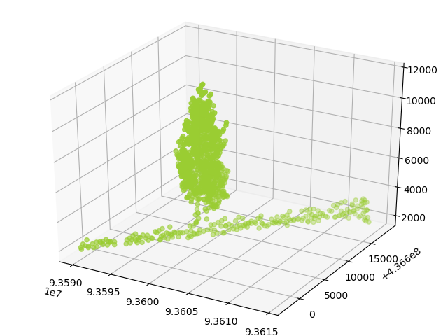


Sub-Planarity Check
Introduction
Methodology
Results
Conclusions

Slide 36

Outlier Removal
Density-Based Spatial Clustering of Applications with Noise (DBSCAN)
Introduction
Methodology
Results
Conclusions
DBSCAN (Pedregosa et Al., 2008)

Slide 37



Outlier Removal
Introduction
Methodology
Results
Conclusions

Slide 38

Modelling Parameters
Tree Top
Introduction
Methodology
Results
Conclusions
Higher Periphery
Periphery
Lower Periphery
Crown Base
Tree Base, Ground Height

Slide 39


Modelling
Introduction
Methodology
Results
Conclusions

Slide 40


Modelling
Introduction
Methodology
Results
Conclusions
Convex Hull
Alpha Shape
Alpha shape (Eich et Al., 2008)

Slide 41
Modelling
Introduction
Methodology
Results
Conclusions
LOD0 LOD1 LOD2 LOD3.0 LOD3.1

Slide 42

Type Classification
Genera
Average intensity
Introduction
Methodology
Results
Conclusions

Slide 43




Type Classification
Clades
Average intensity
Average nr of returns
Introduction
Methodology
Results
Conclusions

Slide 44



Results
Good examples
Introduction
Methodology
Results
Conclusions

Slide 45



Results
Remaining inaccuracies
Introduction
Methodology
Results
Conclusions
Outliers Under-segmentation Misclassification

Slide 46

Results
Introduction
Methodology
Results
Conclusions

Slide 47

Results
Introduction
Methodology
Results
Conclusions

Slide 48

Results
Introduction
Methodology
Results
Conclusions

Slide 49


Results
Introduction
Methodology
Results
Conclusions
Penetrating the irregular ground
Open Gap
Penetration

Slide 50


Comparison
Introduction
Methodology
Results
Conclusions
(Verdie et al., 2008)

Slide 51




Comparison
Introduction
Methodology
Results
Conclusions
(Du, 2019)

Slide 52
Conclusions
How can 3D tree models at varying Levels of Detail be automatically constructed from airborne LiDAR point cloud data?
This implementation shows how
Accuracy is estimated to be up to 70%
Multiple LODs supported
How can a final implementation be made to fit into the 3dfier pipeline?
For simple visualization, it fits
For a seamless fit, more work needs to be done
Introduction
Methodology
Results
Conclusions

Slide 53
Future Work
Ground Truth for AHN3
Post-Segmentation improvements
Tree trunks
Seamless integration 3dfier
Introduction
Methodology
Results
Conclusions

Slide 54
Automatic construction of 3D tree models from airborne LiDAR data in multiple levels of detail
Geert Jan (Rob) de Groot
g.j.robdegroot@gmail.com
Supervisors:
Prof. dr. Jantien Stoter
Dr. Hugo Ledoux

